Slide 1

McGraw-Hill Technology Education
Copyright © 2006 by The McGraw-Hill Companies, Inc. All rights reserved.

Slide 2
LECTURE-1
Introduction to Computer System

Slide 3
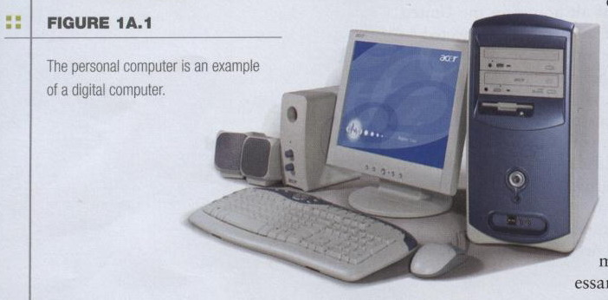
The Computer Defined
Electronic device
Converts data into information
Modern computers are digital
  Two digits combine to make data (0, 1)
1A-<number>

Slide 4
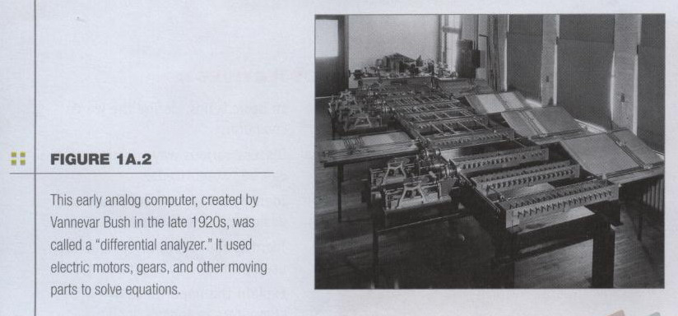
The Computer Defined
Older computers were analog
  A range of values made data
1A-<number>

Slide 5
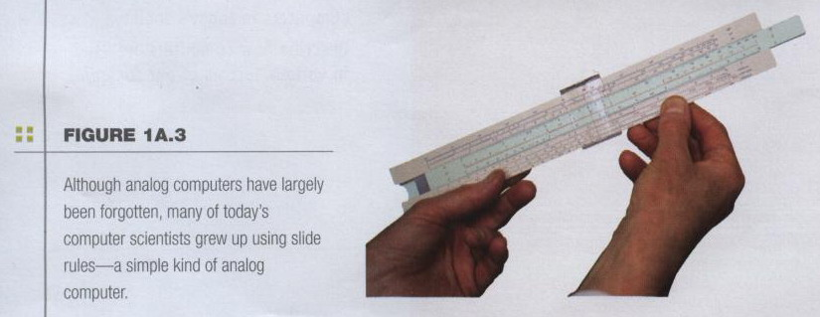
The Computer Defined
Older computers were analog
  A more manageable type -- the old-fashioned slide rule
1A-<number>

Slide 6
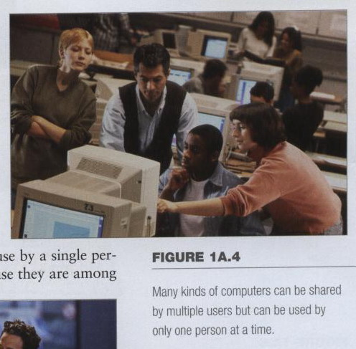
Computers for Individual Use
Computers can
be shared by
multiple users
but can be used
by only one
person at a time.
1A-<number>

Slide 7
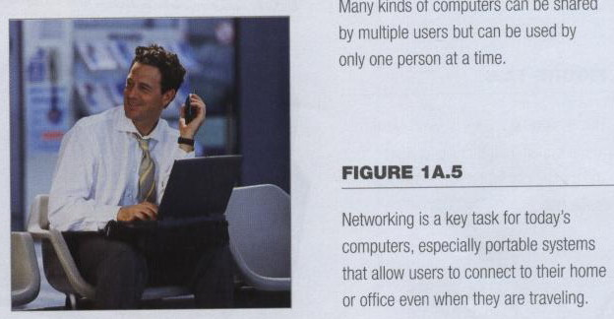
Computers for Individual Use
Although PCs are used by individuals,
they also can be connected together to create networks.
1A-<number>

Slide 8
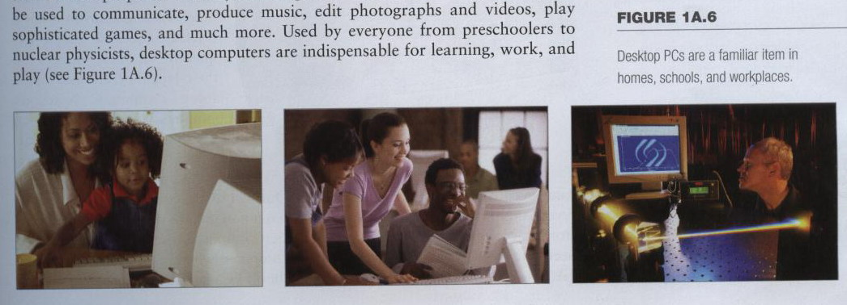
Computers for Individual Use
Desktop computers
  The most common type of computer
  Sits on the desk or floor
  Performs a variety of tasks
1A-<number>
Notes:
Insider information
System units are commonly called cases. Many computer enthusiasts customize or ‘mod’ their cases with windows and lights. See www.casemodgod.com for examples of cases and products.
Sun Microsystems makes the most popular workstations on the planet. Sun’s systems are used in diverse applications such as medical imaging and CGI (computer generated image) animation.

Slide 9
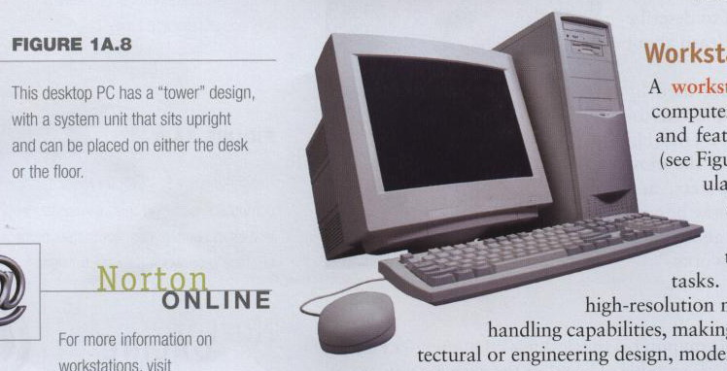
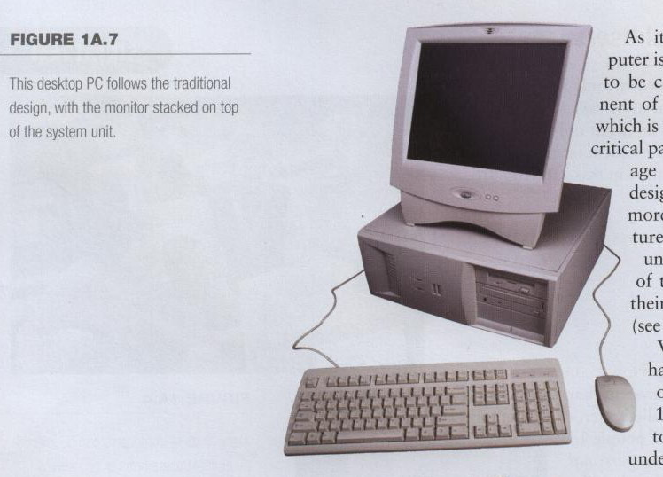
Computers for Individual Use
Desktop computers
  Different design types
1A-<number>

Slide 10
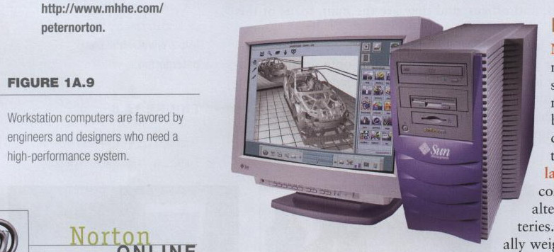
Computers for Individual Use
Workstations
  Specialized computers
  Optimized for science or graphics
  More powerful than a desktop
1A-<number>

Slide 11
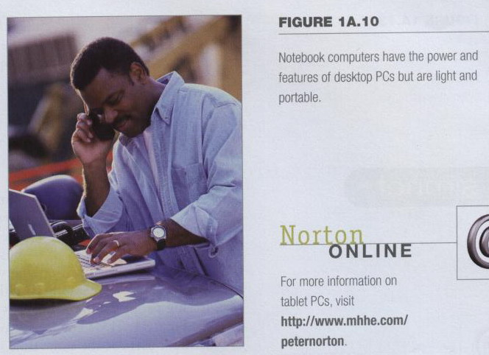
Computers for Individual Use
Notebook computers
  Small portable computers
  Weighs between 3 and 8 pounds
1A-<number>
Notes:
Discussion point
Have students contrast desktop and notebook computers. Focus on the pros and cons of each type of computer.

Slide 12
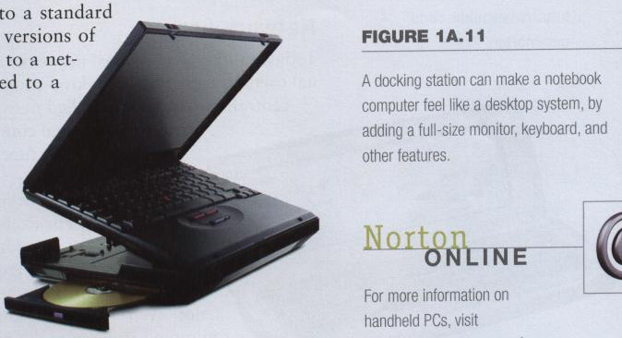
Computers for Individual Use
Notebook computers
  About 8 ½ by 11 inches
  Typically as powerful as a desktop
  Can include a docking station
1A-<number>

Slide 13
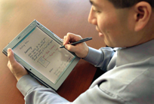
Computers for Individual Use
Tablet computers
  Newest development in portable computers
  Input is through
  a pen
  Run specialized versions of office products
1A-<number>
Notes:
Teaching tip
The tablet PC was designed to simulate a piece of paper. Users interact with the tablet as if it was an unlimited paper notebook.
For more information
See www.microsoft.com/windowsxp/tabletpc/evaluation/tours/default.mspx for an example of the Tablet PC in action.

Slide 14
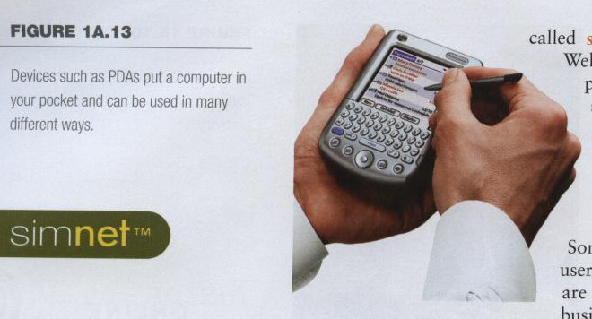
Computers for Individual Use
Handheld computers, palm computer
  Very small computers
  Personal Digital Assistants (PDA)
  Note taking or contact management
  Data can synchronize with a desktop
1A-<number>
Notes:
Teaching tip
At this point, refer the students to the productivity tip on page 13. This tip helps the student determine what type of PC is best for them.

Slide 15
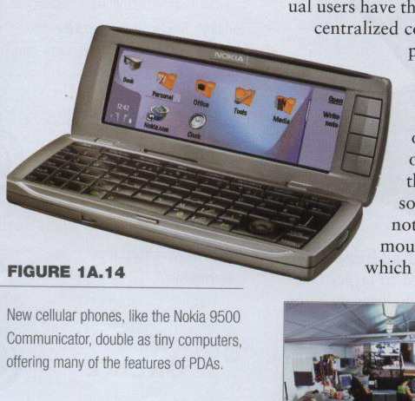
Computers for Individual Use
Smart phones
  Hybrid of
  cell phone
  and PDA
  Web surfing,
  e-mail access
1A-<number>

Slide 16
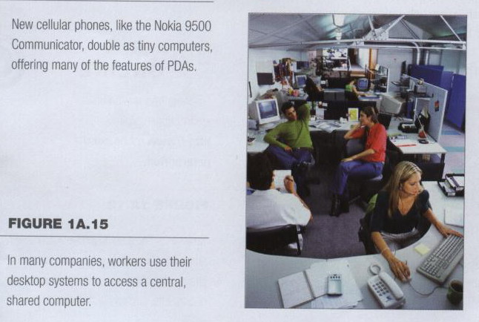
Computers for Organizations
Network servers
  Centralized computer
  All other computers connect
1A-<number>

Slide 17
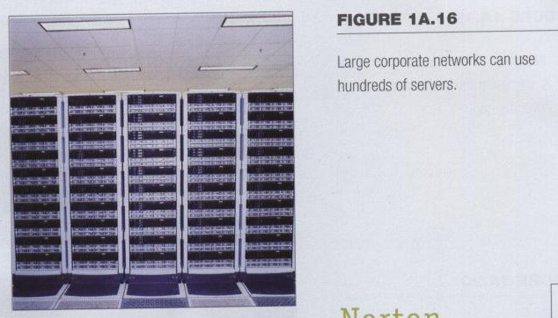
Computers for Organizations
Network servers
  Provides access to network resources
  Multiple servers are called server farms
  Often simply a powerful desktop: Google
1A-<number>

Slide 18
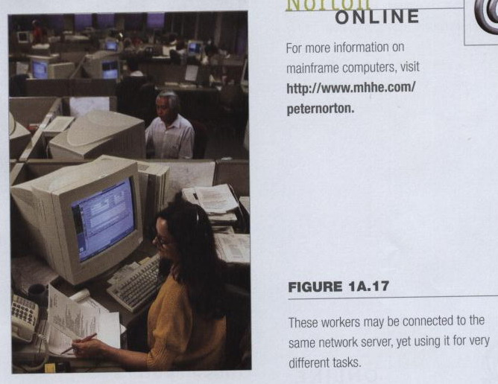
Computers for Organizations
Network servers
  Flexibility to different kinds of tasks
Computers for Organizations
Computers for Organizations
1A-<number>

Slide 19
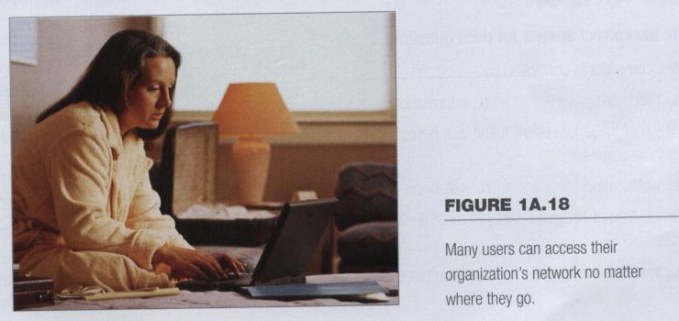
Computers for Organizations
Network servers
  Users use the Internet as a means of connecting even if away from the offices.
1A-<number>

Slide 20
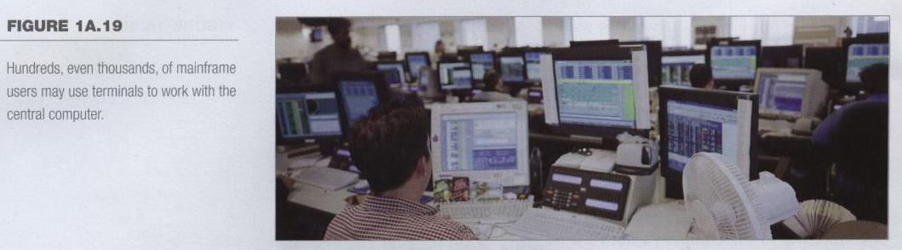
Computers for Organizations
Mainframes
  Used in large organizations
  Handle thousands of users
  Users access through a terminal
1A-<number>

Slide 21
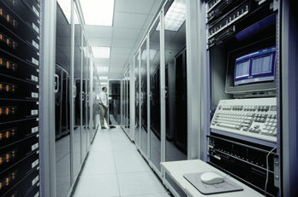
Computers for Organizations
Mainframes
  Large and powerful systems
1A-<number>

Slide 22
Computers for Organizations
Minicomputers
  Called midrange computers
  Power between mainframe and desktop
  Handle hundreds of users
  Used in smaller organizations
  Users access through a terminal
1A-<number>

Slide 23
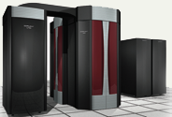
Computers for Organizations
Supercomputers
  The most powerful computers made
  Handle large and complex calculations
  Process trillions of operations per second
  Found in research organizations
1A-<number>
Notes:
Teaching tip
Students have a hard time understanding trillions of calculations. A simple explanation is to add 1 trillion random numbers together in a second. Contrast the speed of a super computer to the fastest desktop computer advertised during the week of class.

Slide 24
Computers in Society
More impact than any other invention
  Changed work and leisure activities
  Used by all demographic groups
Computers are important because:
  Provide information to users
  Information is critical to our society
  Managing information is difficult
1A-<number>

Slide 25
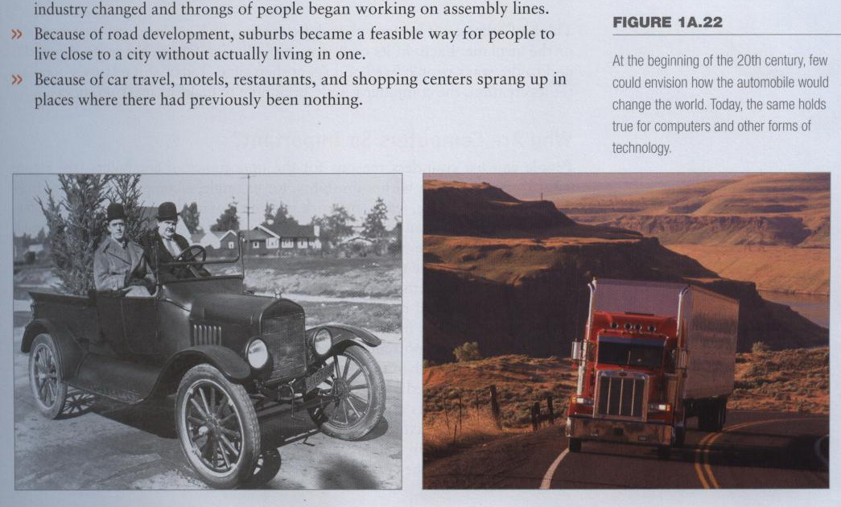
Computers in Society
Impact of computers
  Like the Impact of automobile
1A-<number>

Slide 26
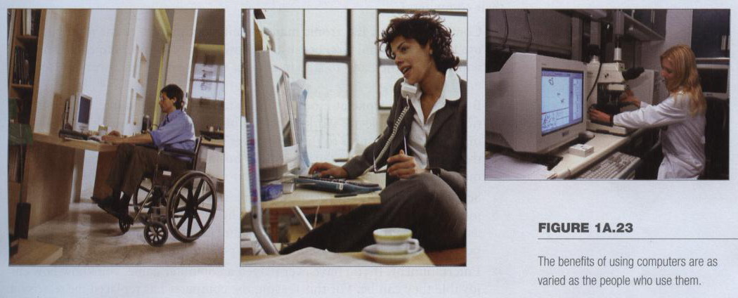
Computers in Society
The benefits of using computers
  As varied as users
1A-<number>

Slide 27
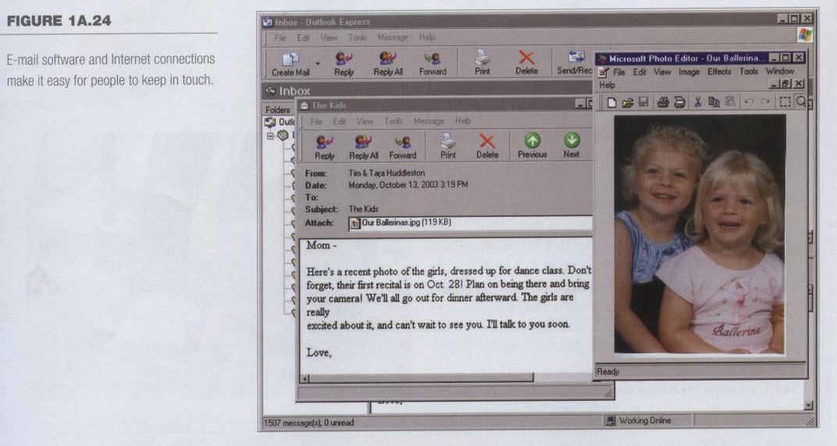
Computers in Society
Computers at home
  Many homes have multiple computers
  Most American homes have Internet
  Computers are used for
    Communication
1A-<number>
Notes:
Insider information
The 2000 Census determined that 51% of American households had computers. Over 42% of these households also had Internet access. This can be contrasted to 36% and 18% in 1997. See www.census.gov/prod/2001pubs/p23-207.pdf for more information.

Slide 28
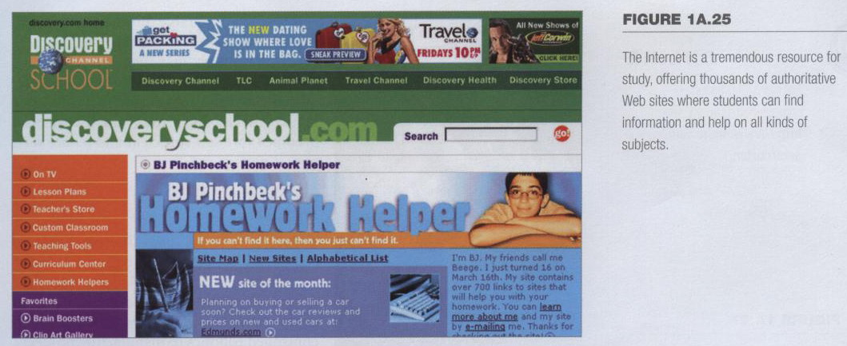
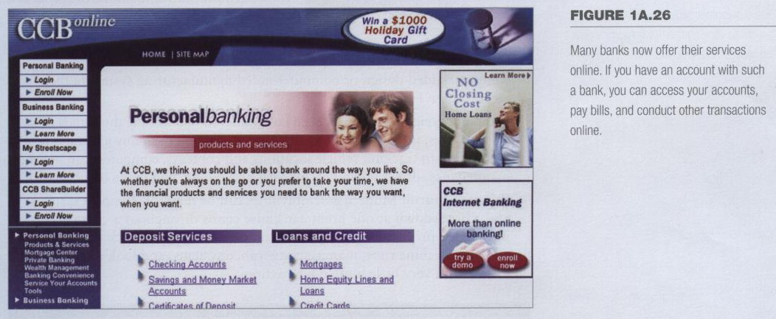
Computers in Society
Computers at home
  Computers are used for
    Business
    Entertainment
    Schoolwork
    Finances
1A-<number>

Slide 29
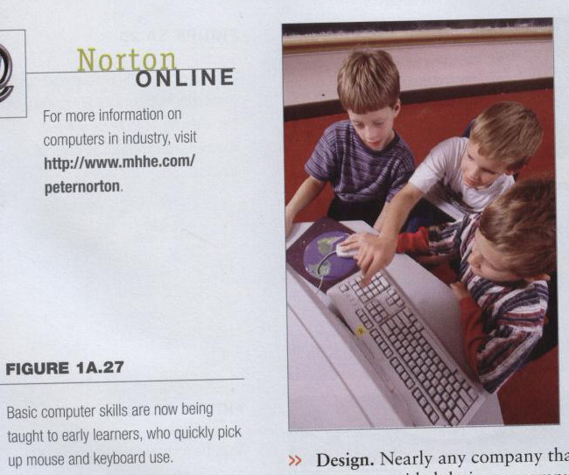
Computers in Society
Computers in education
  Computer literacy required at all levels
1A-<number>
Notes:
Insider information
Specialized mountain bikes are designed on Sun workstations.

Slide 30
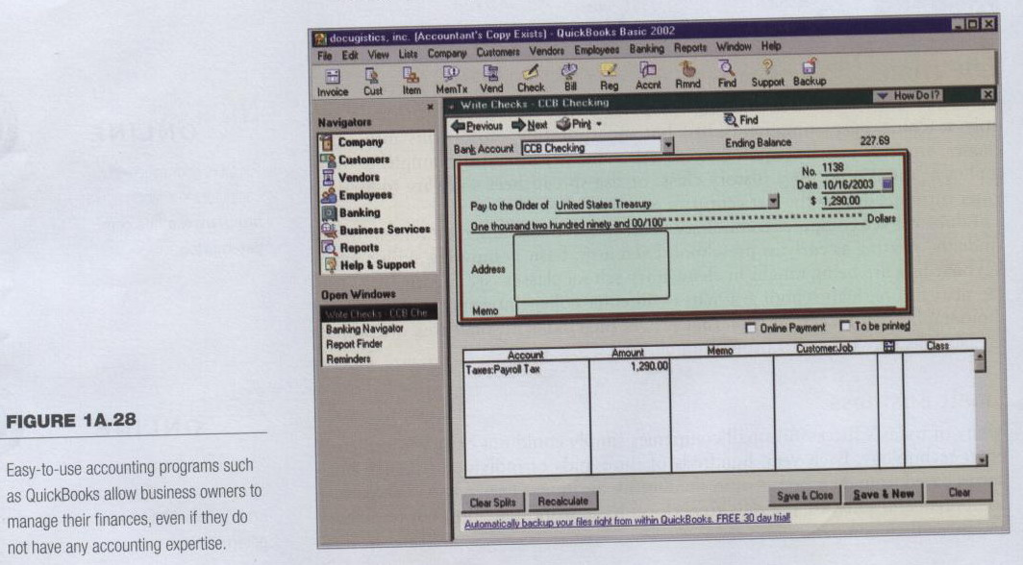
Computers in Society
Computers in small business
  Makes businesses more profitable
  Allows owners to manage
1A-<number>

Slide 31
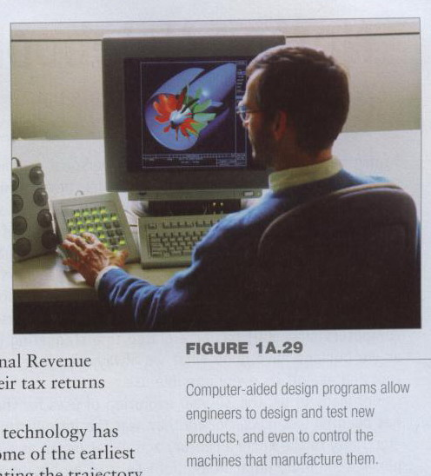
Computers in Society
Computers in industry
  Computers are
  used to design
  products
  Assembly
  lines are
  automated
1A-<number>

Slide 32
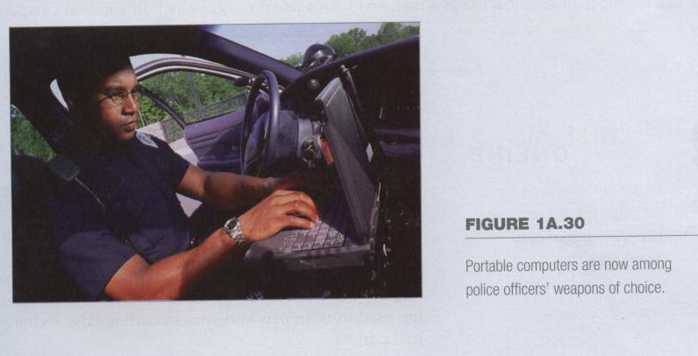
Computers in Society
Computers in government
  Necessary to track data for population
    Police officers
    Tax calculation and collection
  Governments were the first computer users
1A-<number>
Notes:
Teaching tip
Most state departments of motor vehicles rely on a mainframe computer. Officers access the mainframe from a remote intelligent terminal.

Slide 33
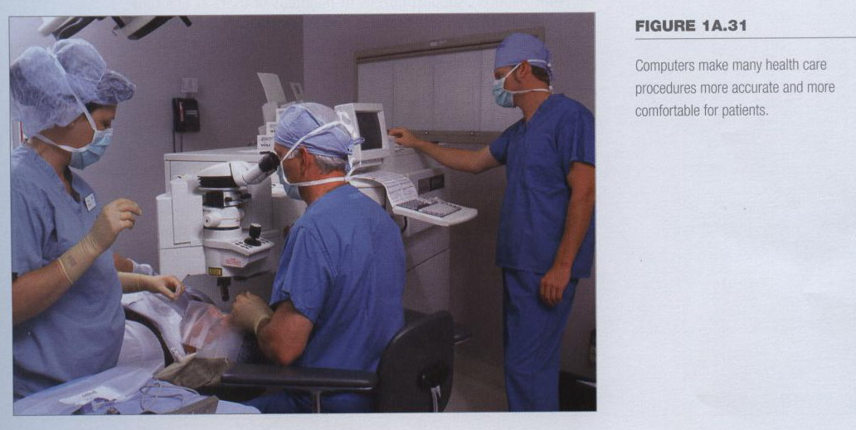
Computers in Society
Computers in health care
  Revolutionized health care
  New treatments possible
  Scheduling of patients has improved
  Delivery of medicine is safer
1A-<number>
Notes:
Discussion point
Page 19 of the text introduces the first Norton Notebook, the Merging of Media and Meaning. The author draws an analogy between electricity and computers in our lives. Discuss with your students how difficult live would be without either of these devices. Remember that computers exist in nearly all of our modern devices, including cars, phones, kitchen appliances and entertainment devices.

Slide 34
Assignment
What is a computer?
Explain a few of the different ways in which computers can be categorized.
List six types of computers that are designed for use by a single person.
Describe the two common designs for desktop computers.
How much do notebook computers typically weigh?
List four types of computers that are designed for use by organizations, and are commonly used by multiple people at the same time.
1A-<number>

Slide 35
Assignment
7. Why are mainframe systems usually limited in the number of tasks they perform?
8. What is the most popular use for home computers?
9. How are computer technologies used by the military?
10. How are computer technologies being used to train surgeons?
1A-<number>

Slide 36
PC Information
Open your personal computer at home and list the hardware specification as detailed as possible, including the manufacturer, product type, and serial number. List every software installed on your personal computer. For example:
PC:
CPU:
Motherboard:
SDRAM:
hard disk:
monitor: Model:
power supply:
keyboard:
speakers:
mouse:
anti-virus software:
OS:
productivity software:
1A-<number>

